Slide 1

GreenWEB Webinar Series
Healthy and Sustainable Food Systems in Health Care
Presented by the Canadian Coalition for Green Health Care

Slide 2
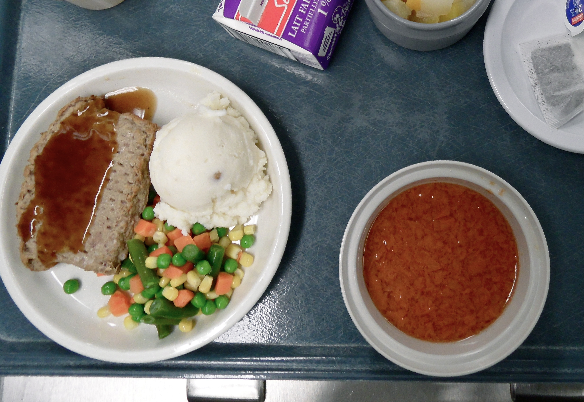

Slide 3


Slide 4
Outline
Putting Sustainability in Context.
Why Local and Sustainable Food Systems are Important.
Explore the current food system in Healthcare.
How these systems can support local food systems.

Slide 5
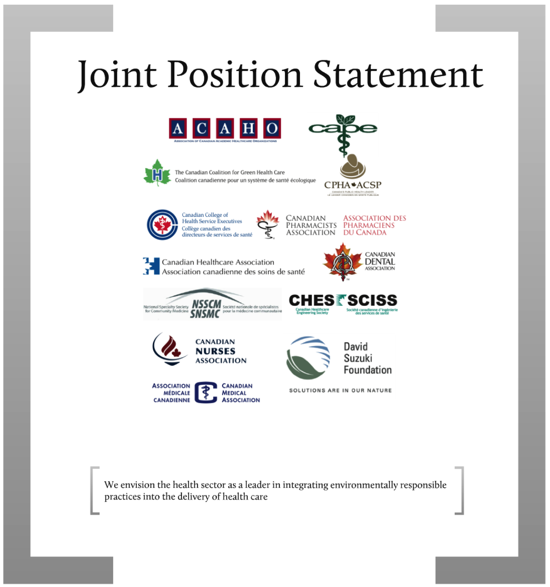

Slide 6
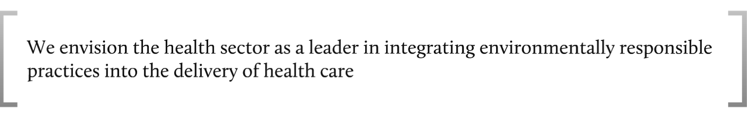

Slide 7


Slide 8
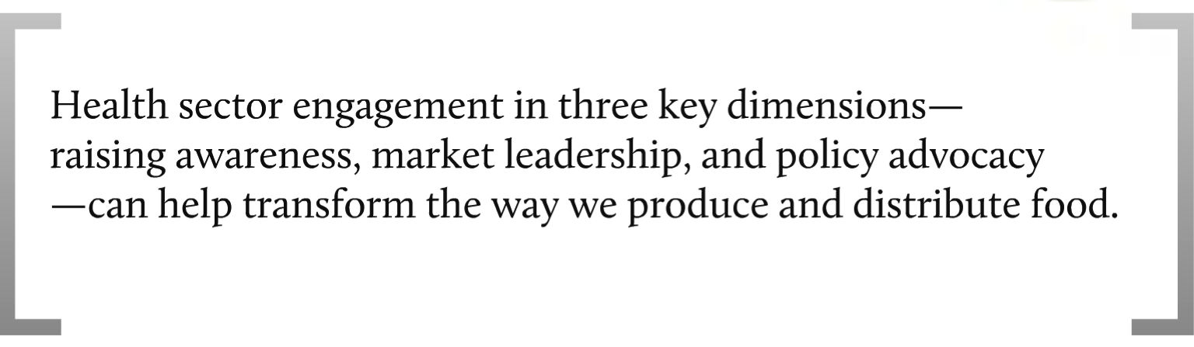

Slide 9
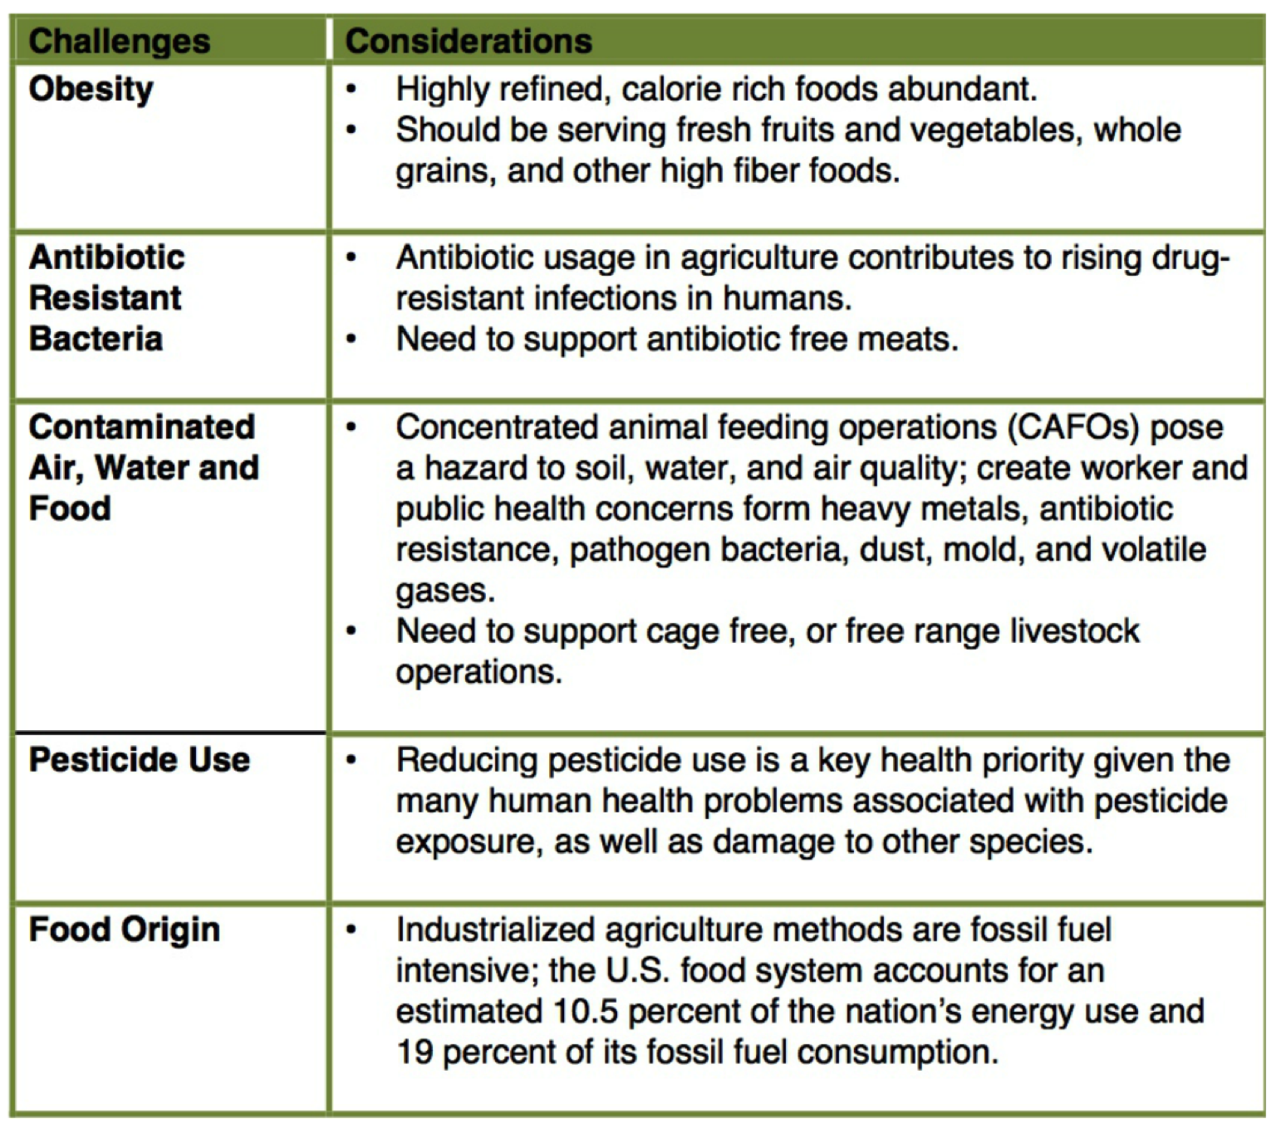

Slide 10
Why Local?

Slide 11
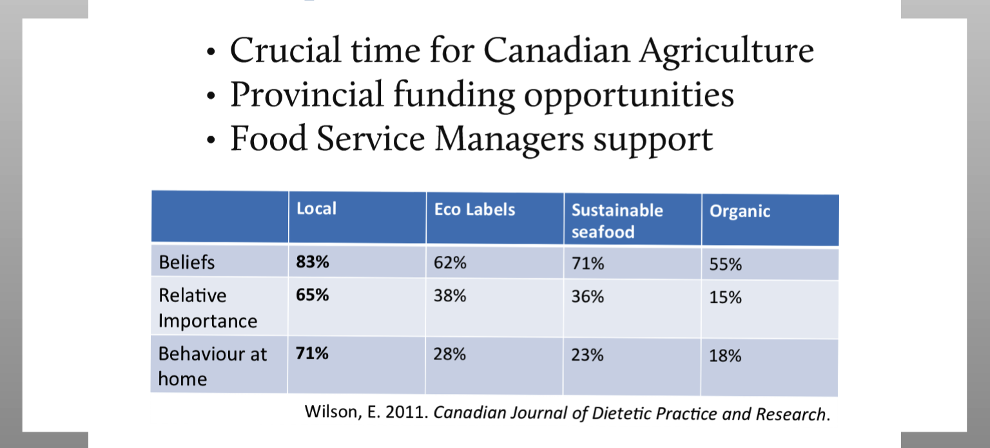
Perfect Storm

Slide 12
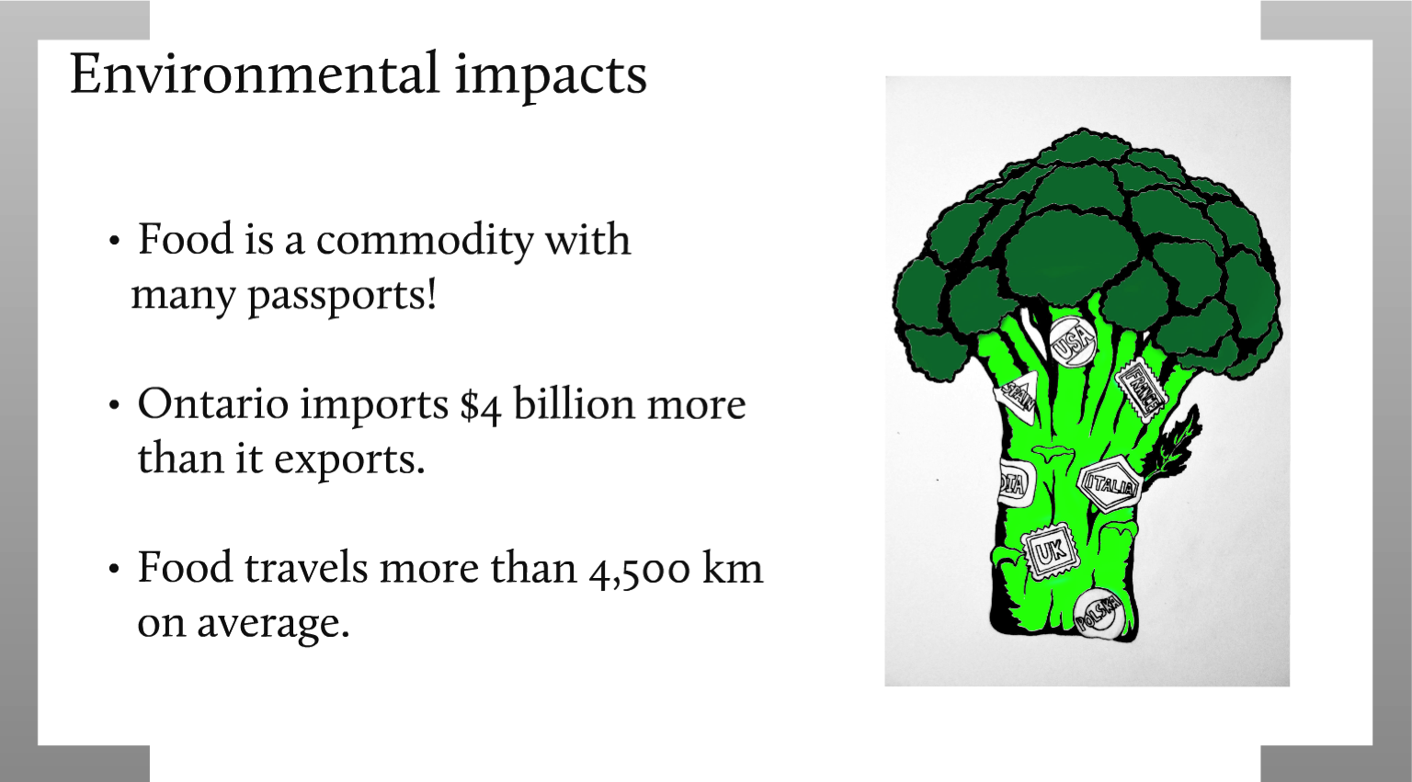

Slide 13
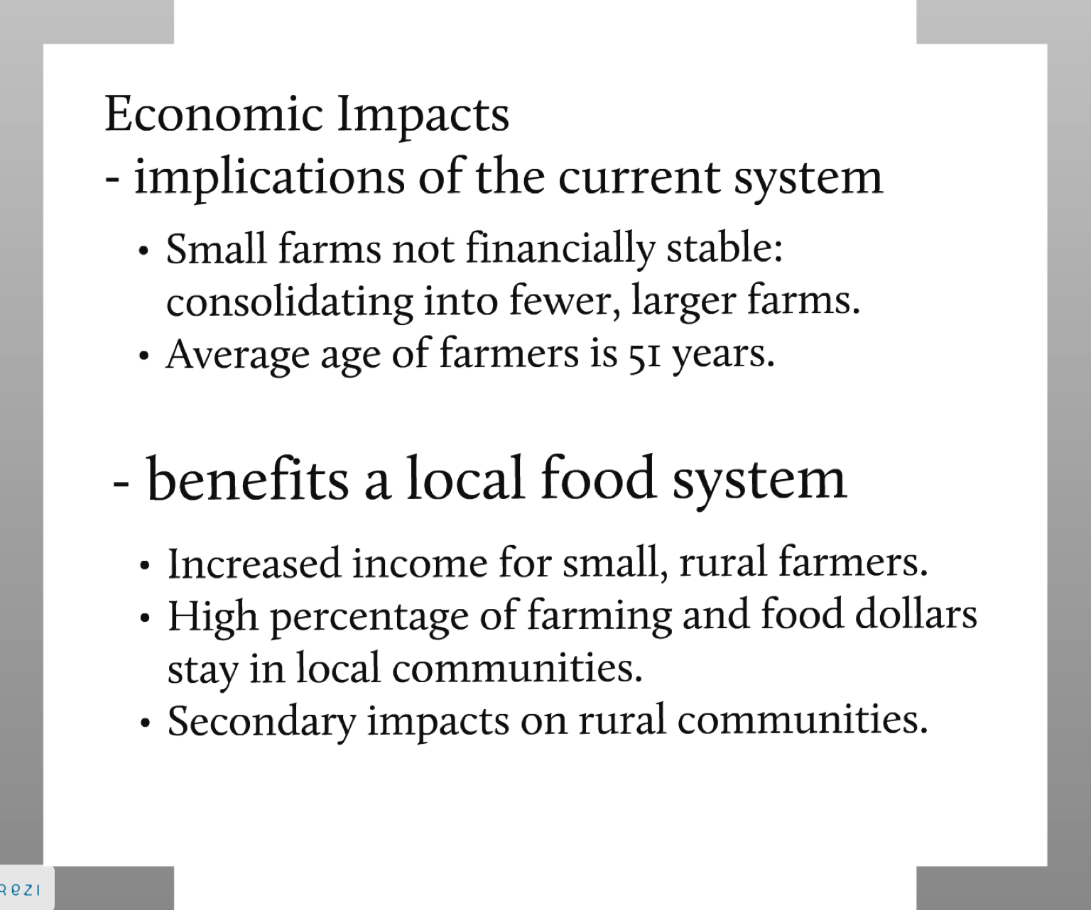

Slide 14
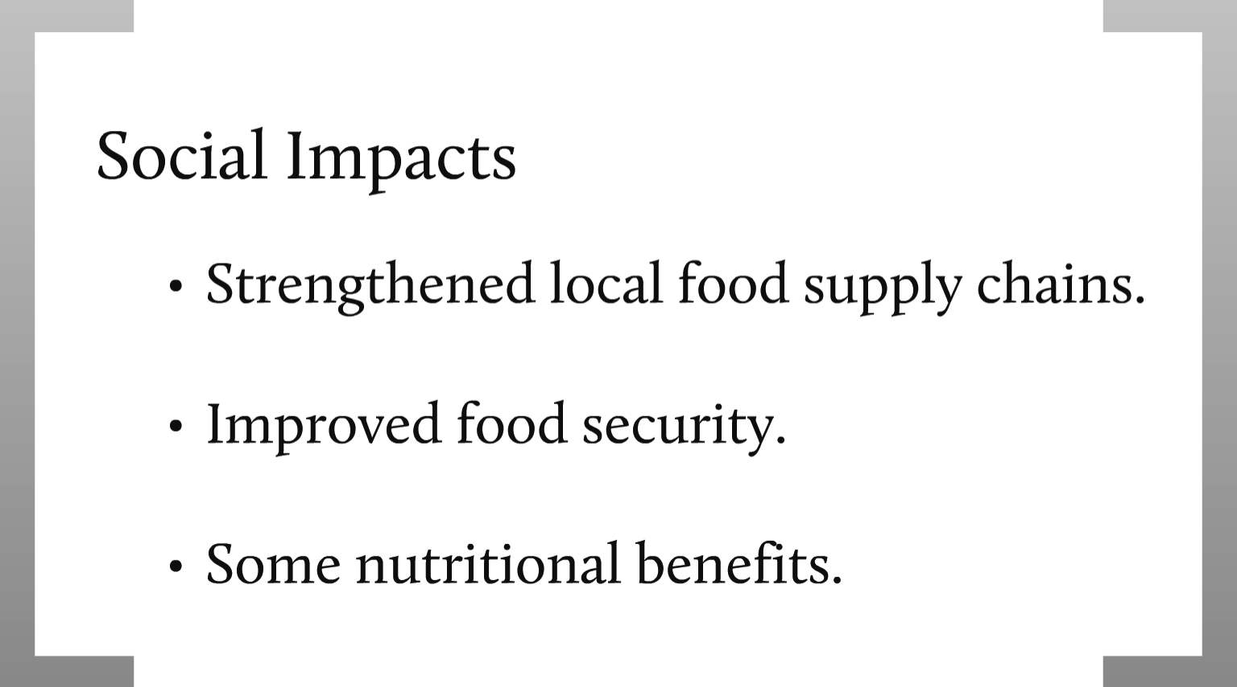

Slide 15
Why Health Care?

Slide 16
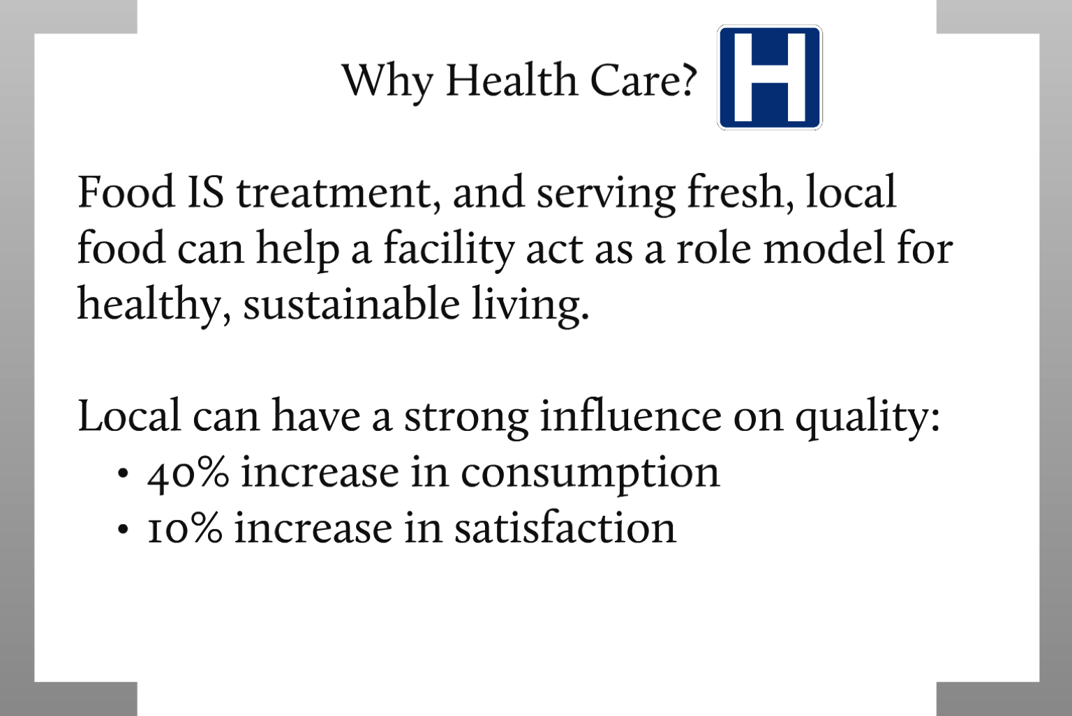

Slide 17
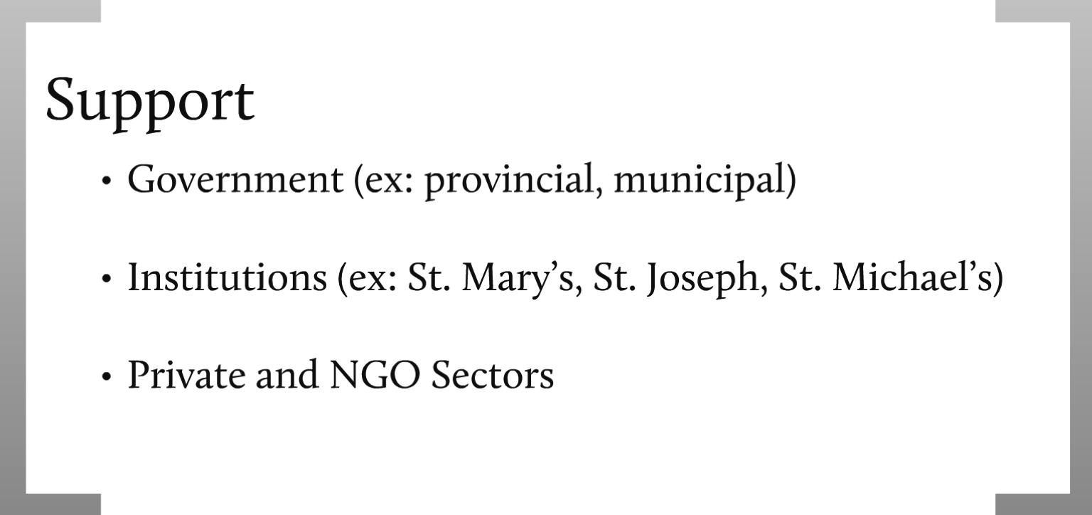

Slide 18
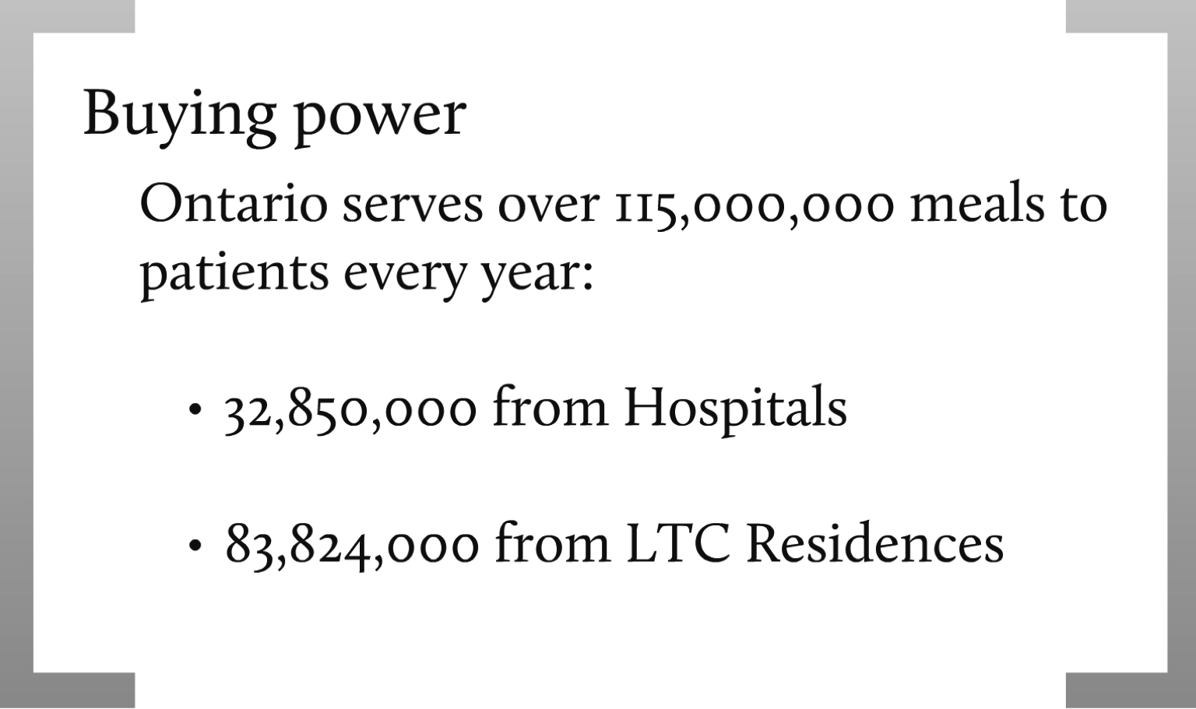

Slide 19
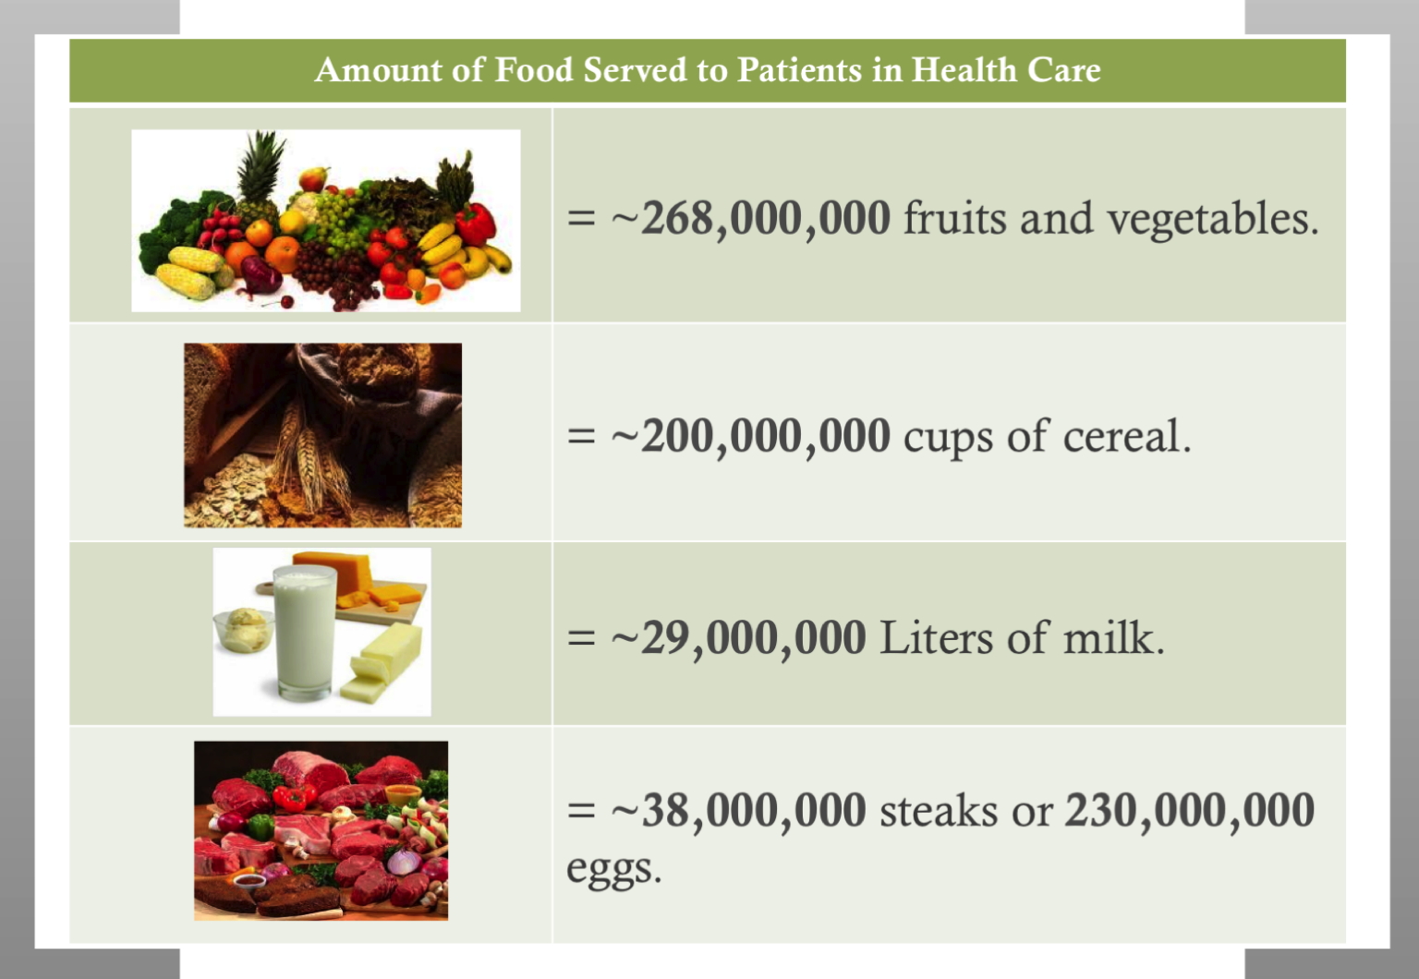

Slide 20
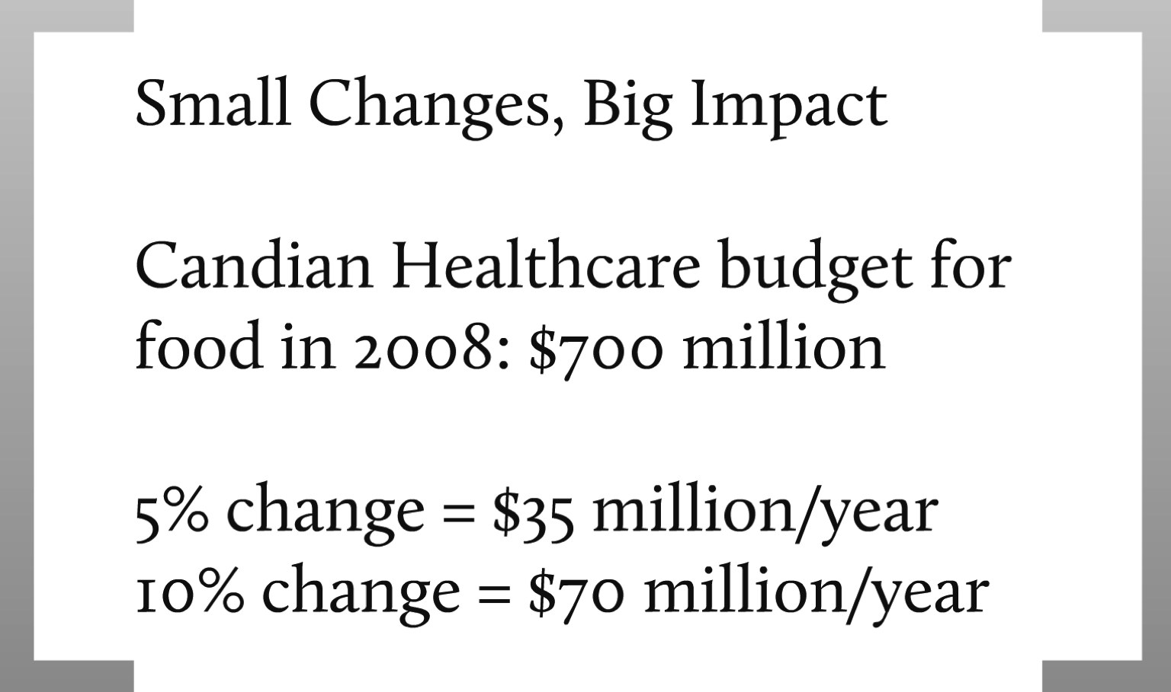

Slide 21
Assessing Opportunities

Slide 22
Can’t Manage Something you Don’t Understand
Feasibility Studies
Ontario Trillium Foundation (2009-2010)
OMAFRA/UofG Partnership Fund (2010-2013)

Slide 23
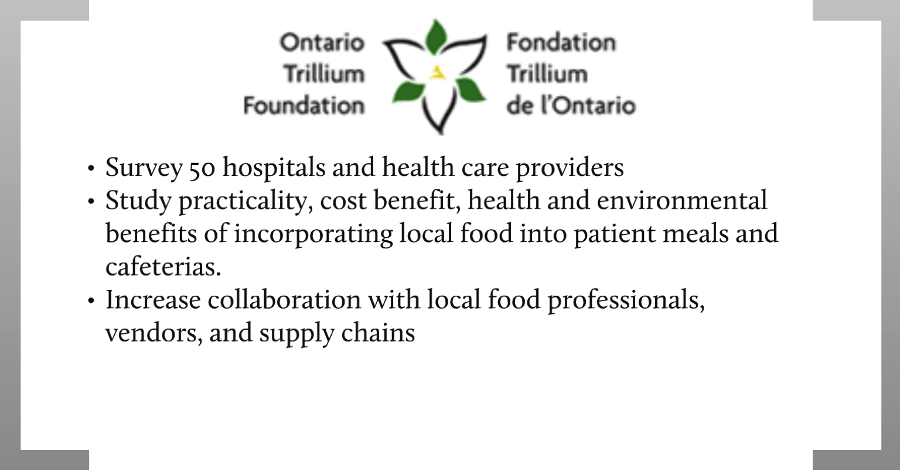

Slide 24


Slide 25
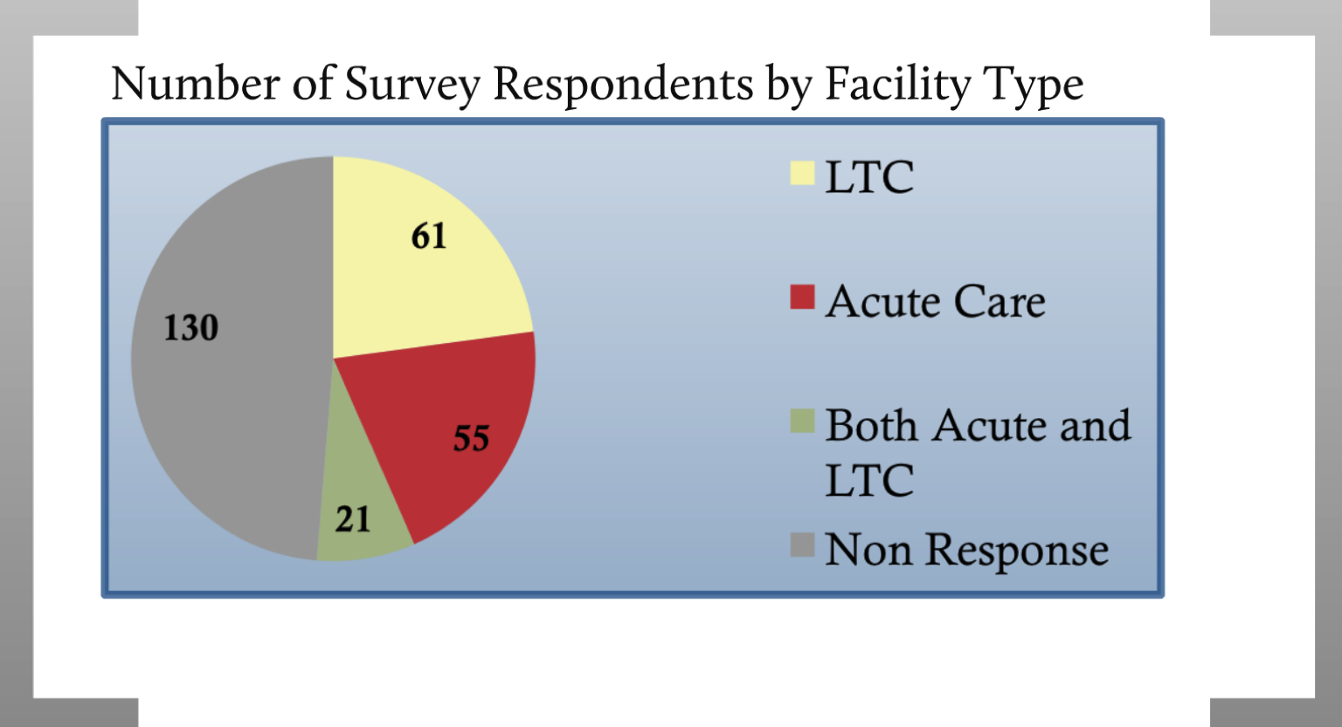

Slide 26


Slide 27
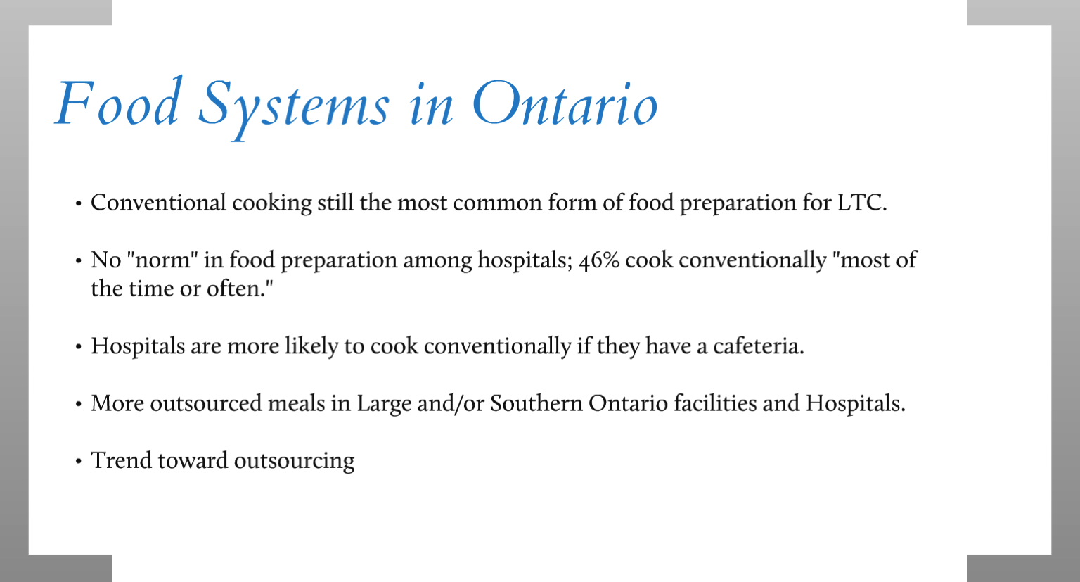

Slide 28
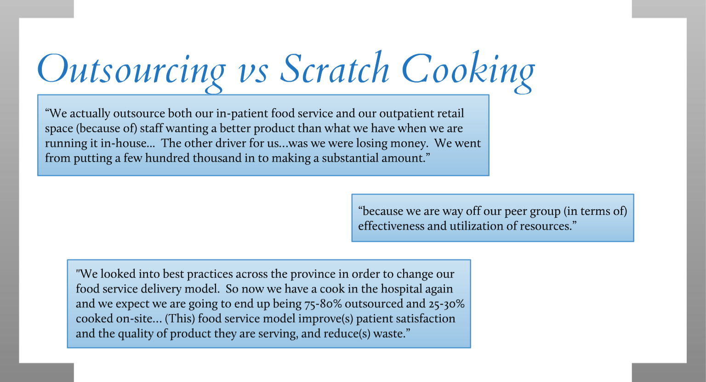

Slide 29
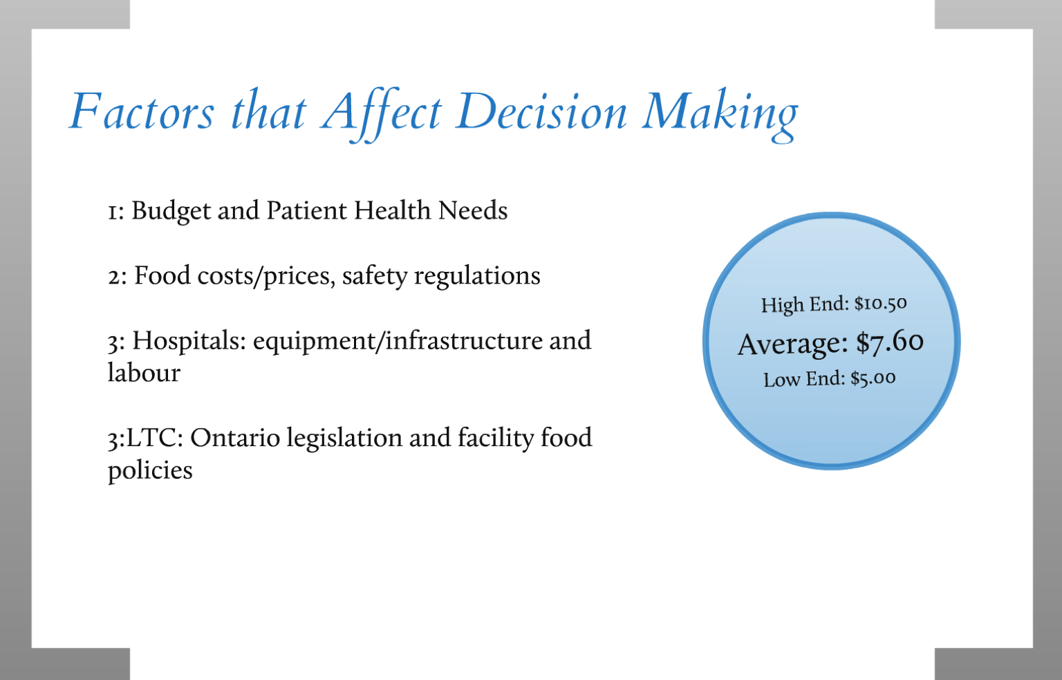

Slide 30
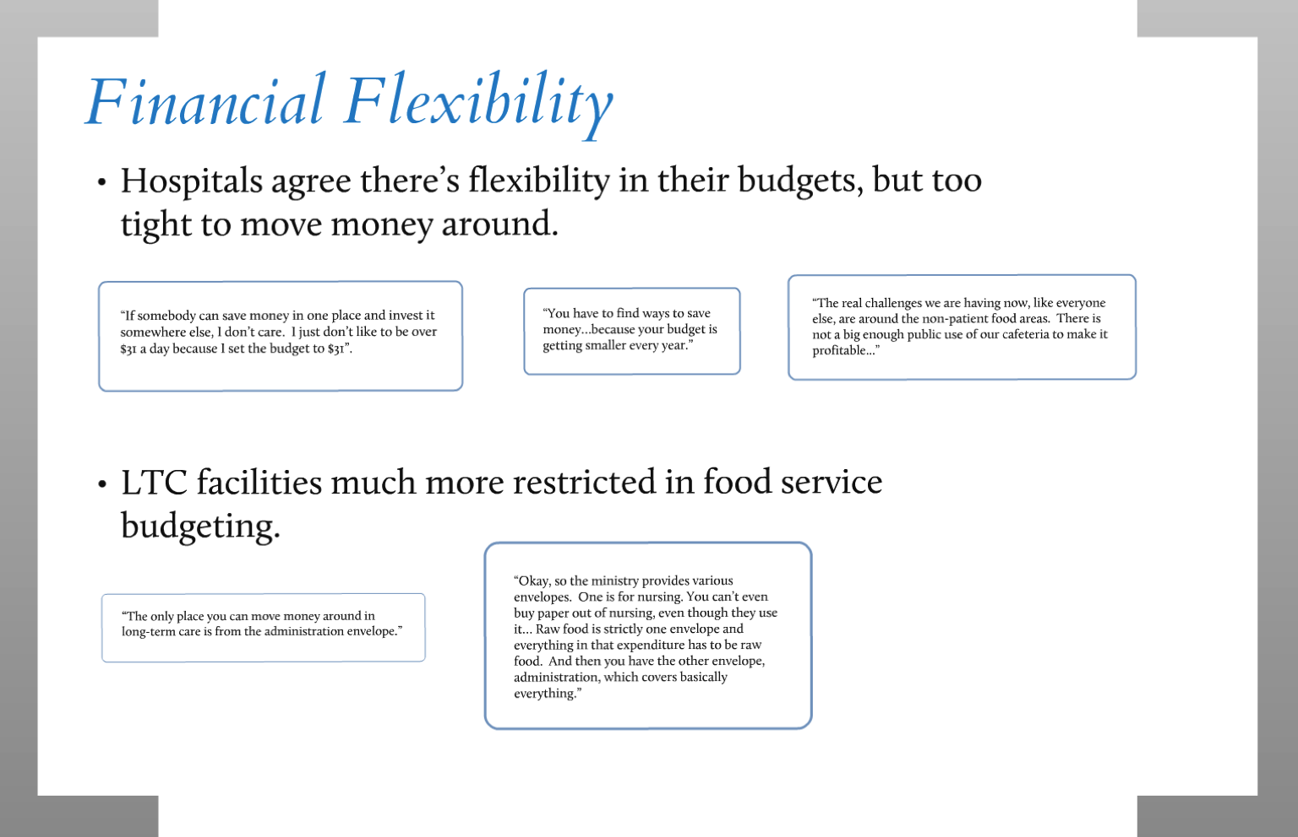

Slide 31
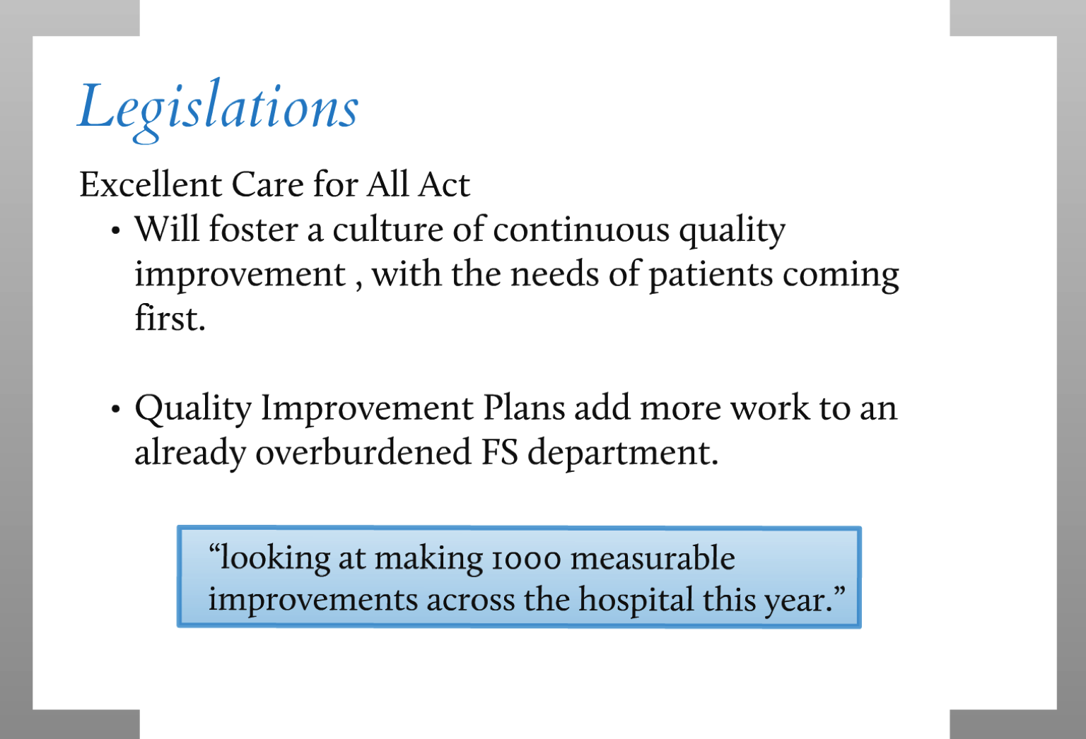

Slide 32
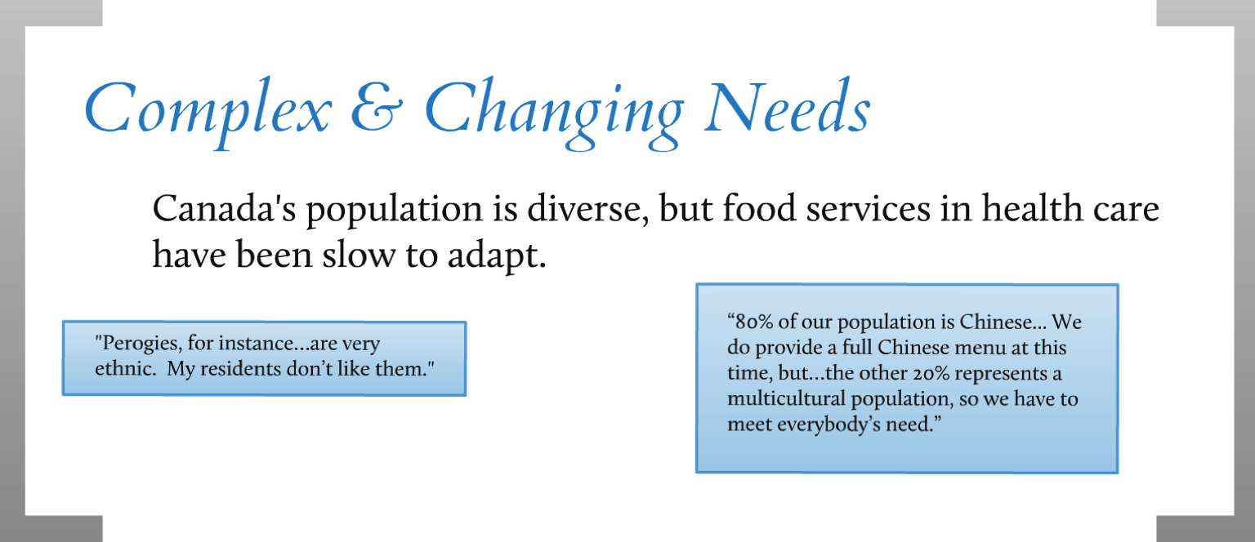

Slide 33
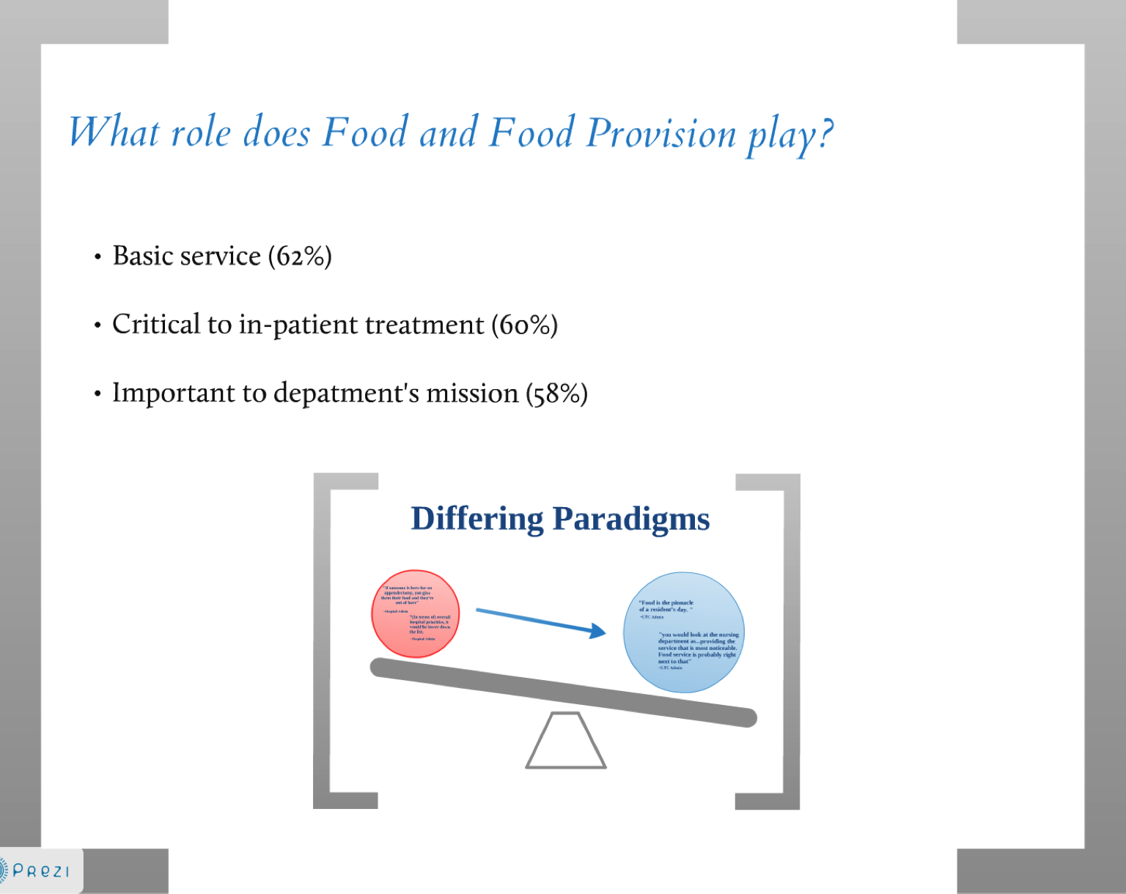

Slide 34
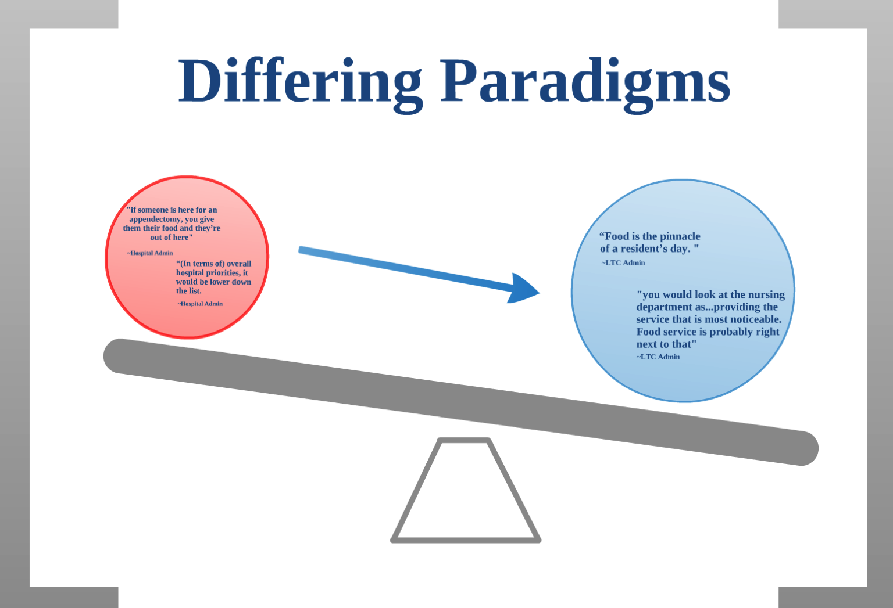

Slide 35
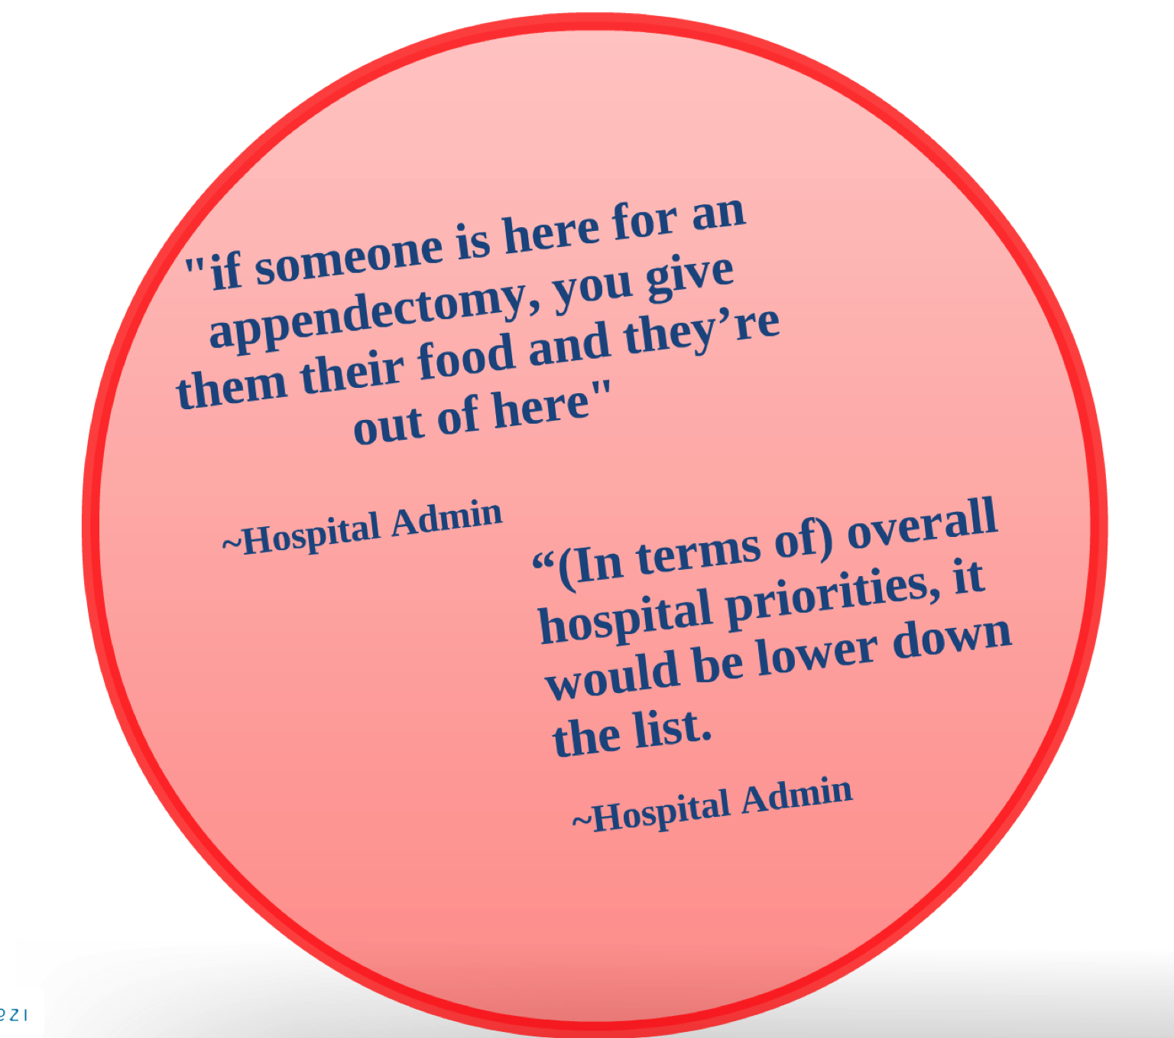

Slide 36
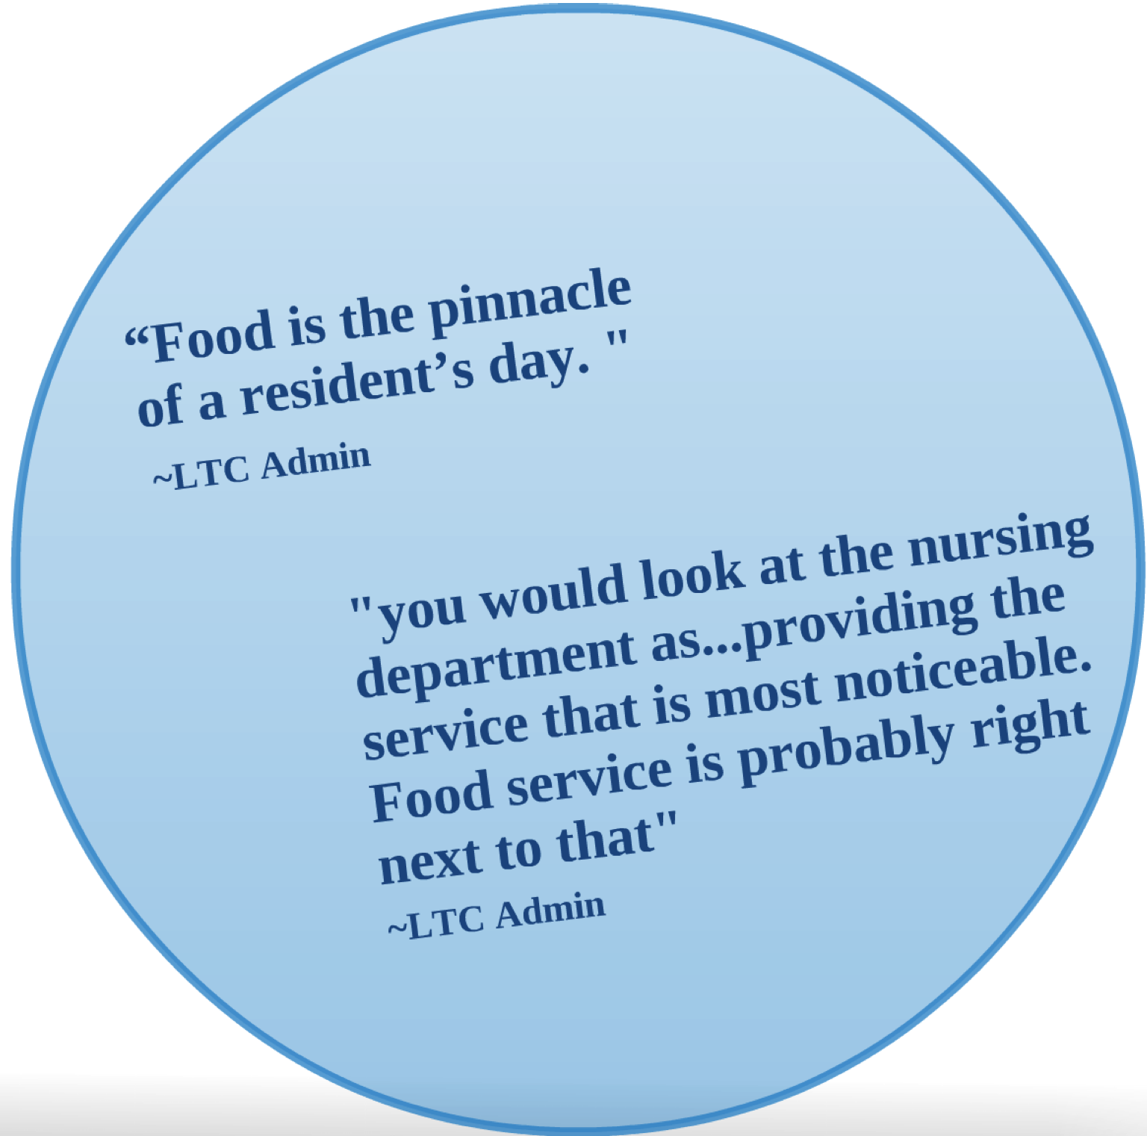

Slide 37
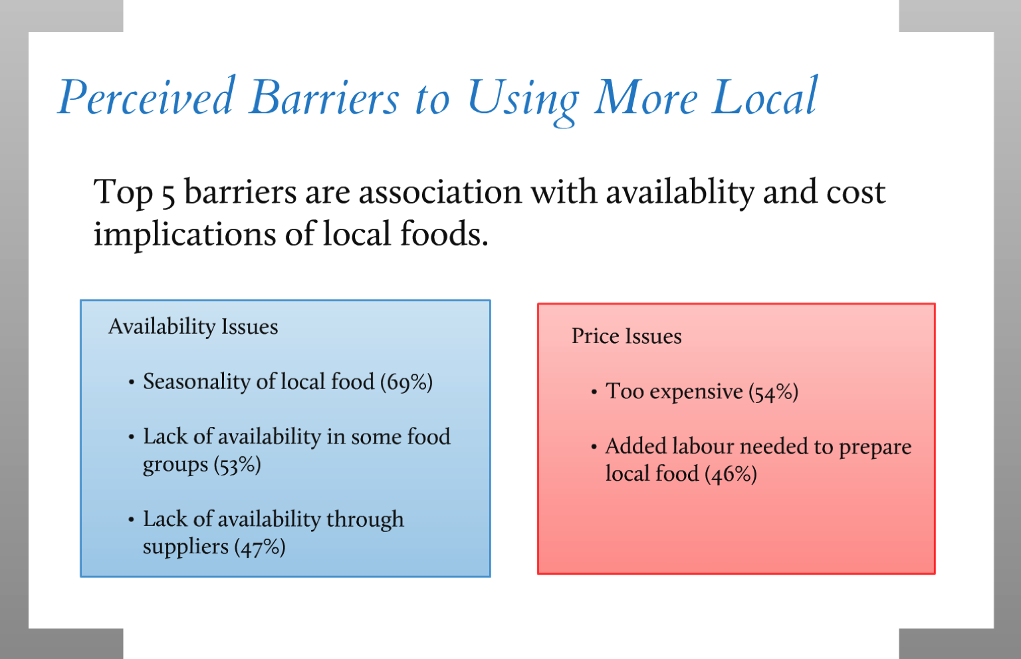

Slide 38
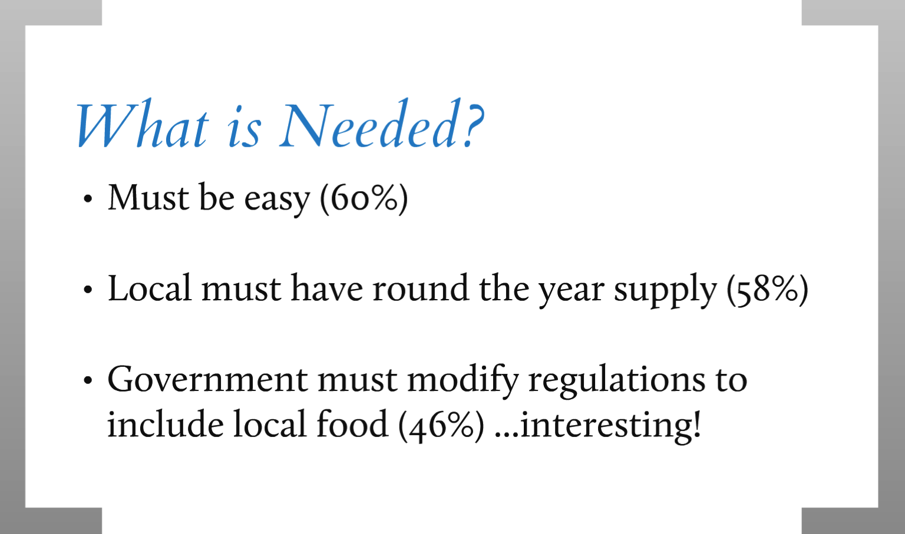

Slide 39
System Overview
Solutions have to be easy!
  Food Services are complicated
  The importance of food varies
  Supply and availability are problems for local food

Slide 40
What is Happening Now?

Slide 41
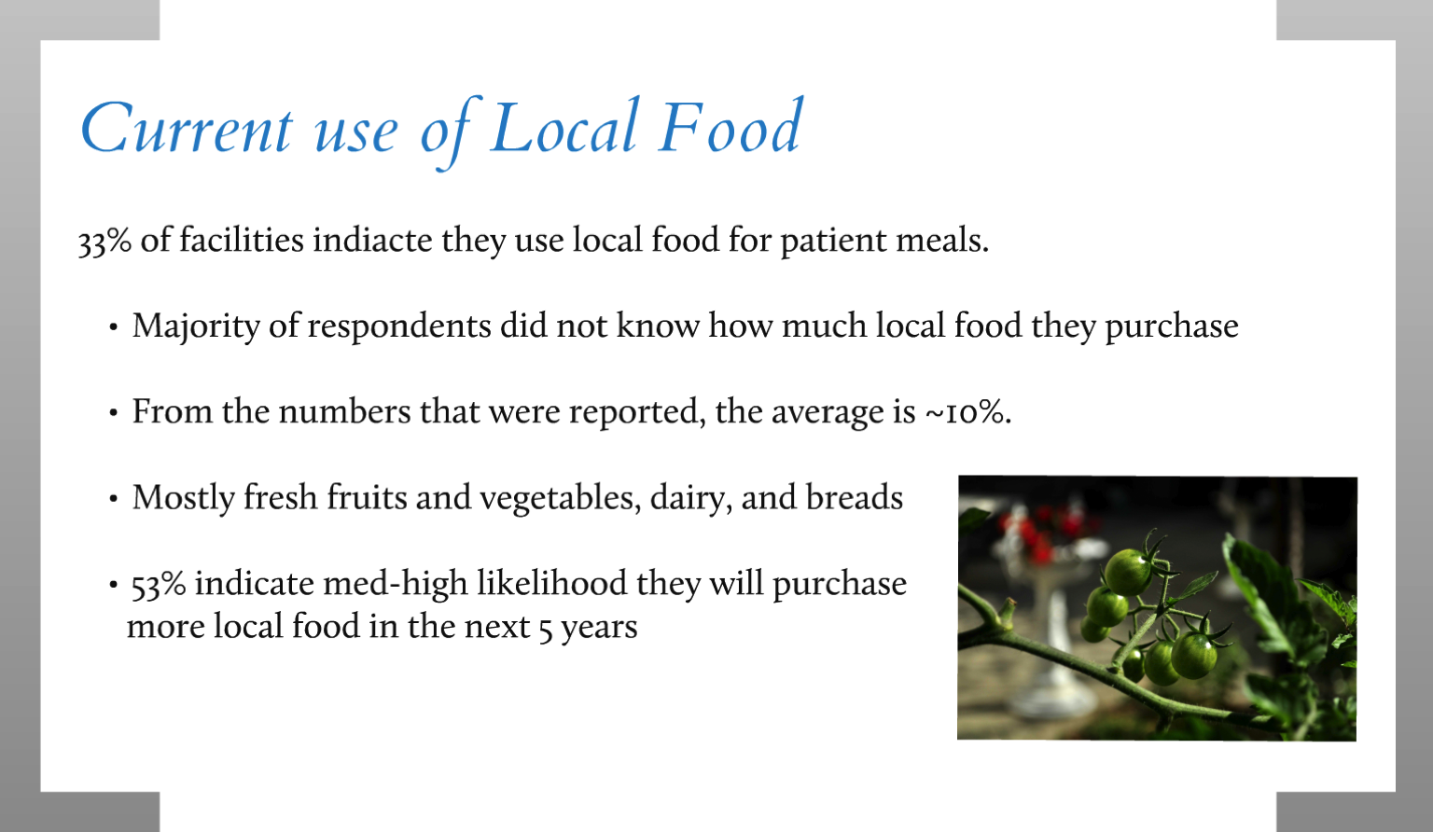

Slide 42
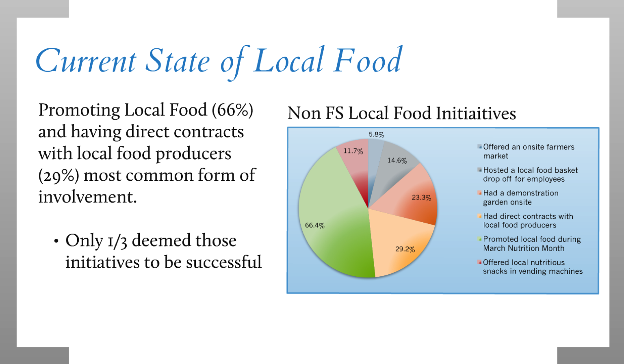

Slide 43

Breaking Down Barriers
Goal to increase the amount of Local Food in Health Care.
  How much local food is currently served in healthcare
  Measurable change and benchmarking

Slide 44


Slide 45
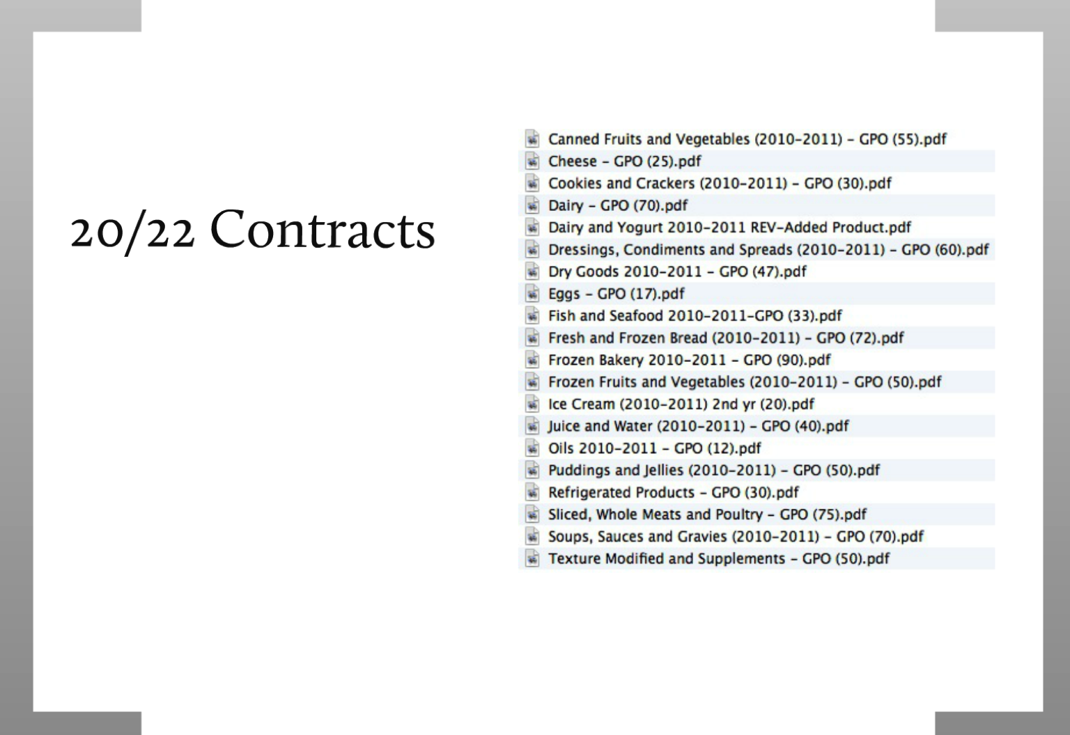

Slide 46
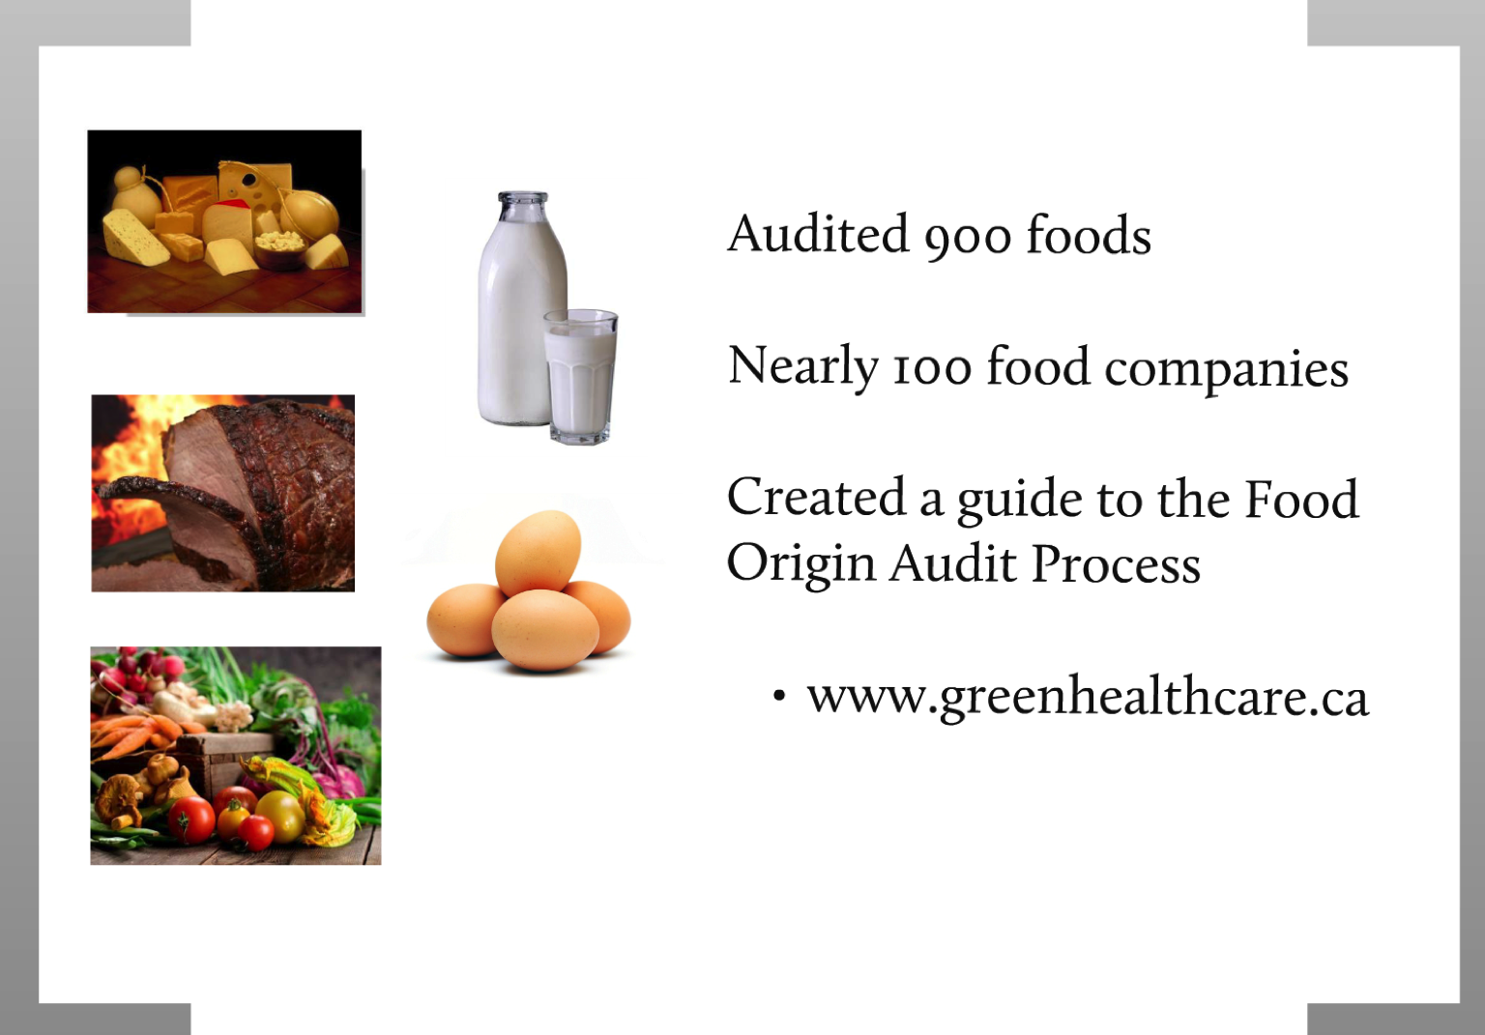

Slide 50
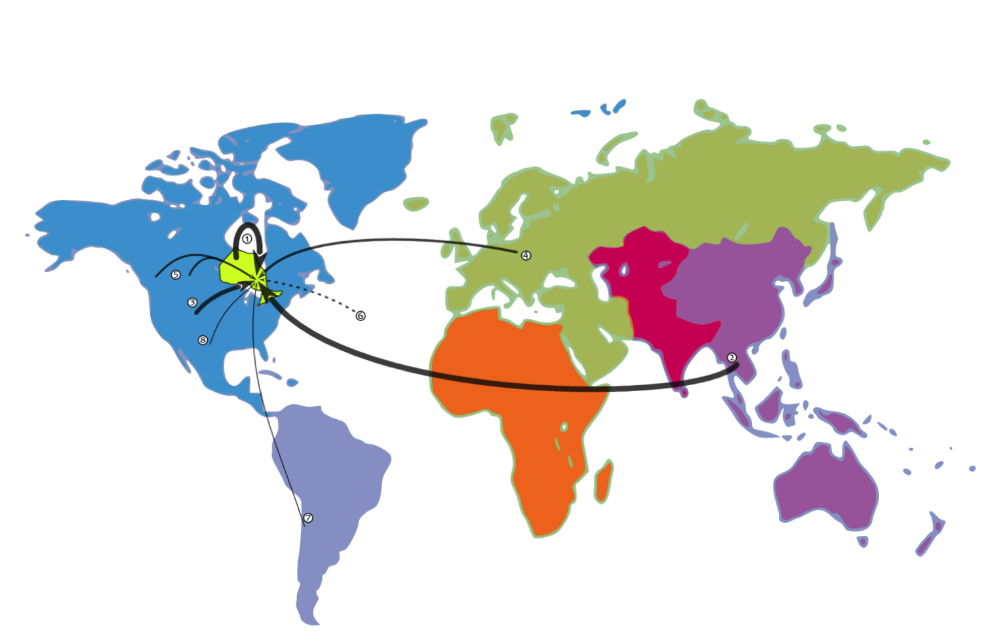

Slide 51
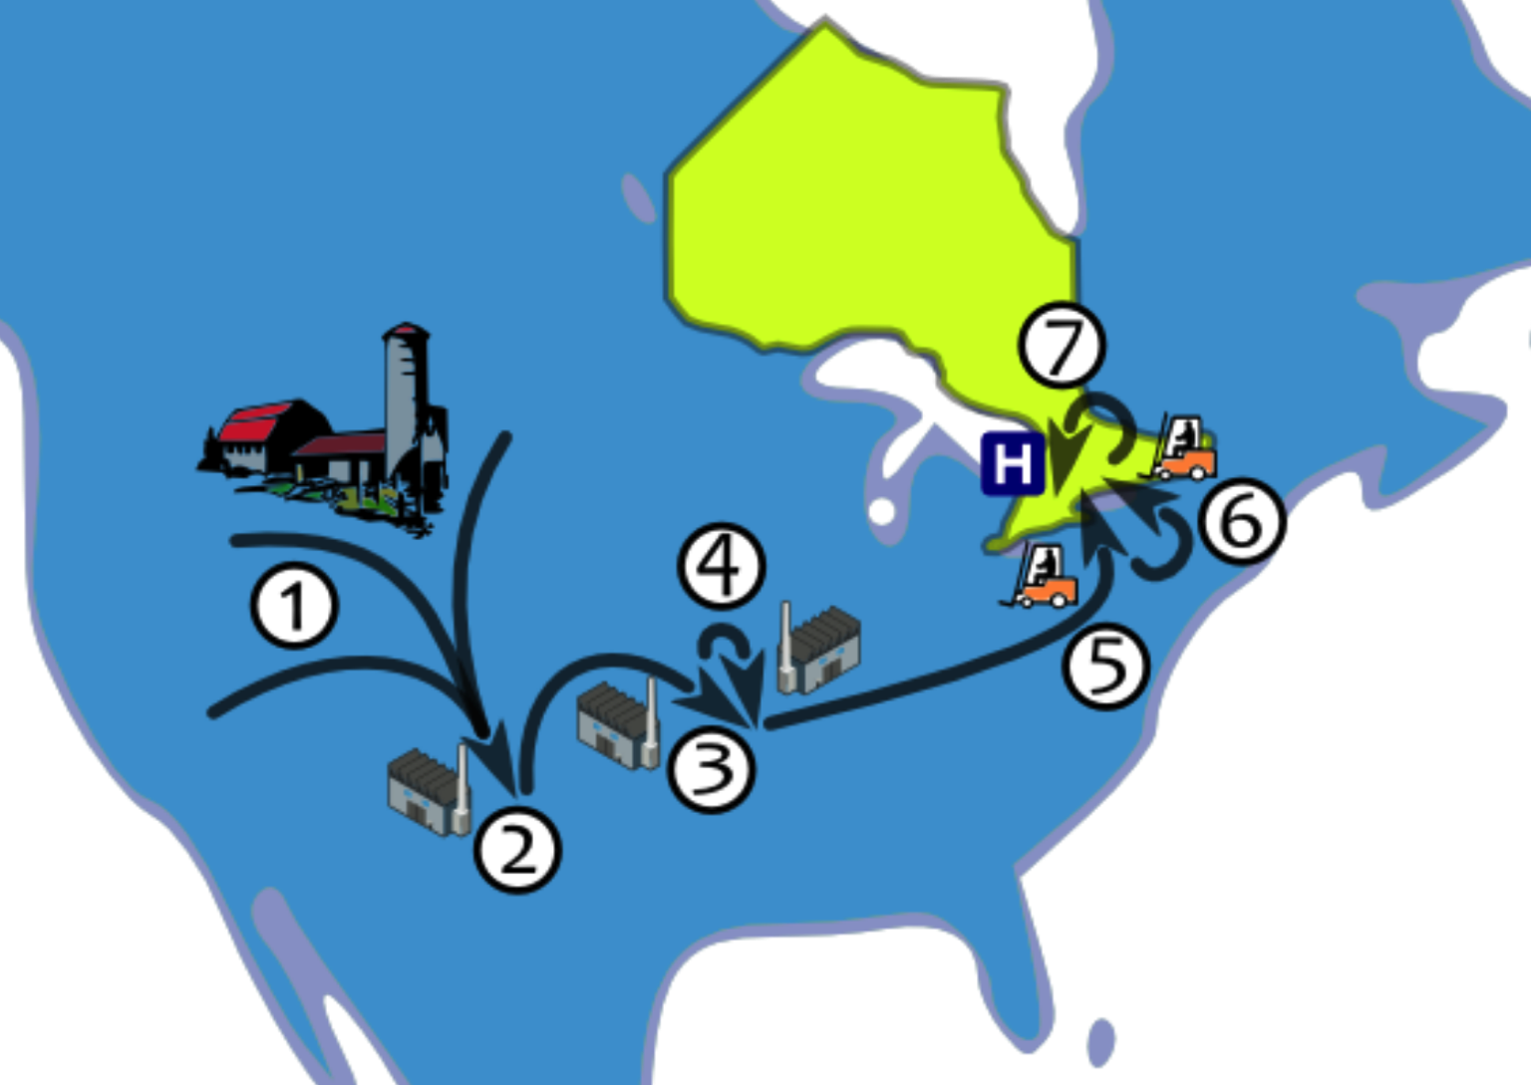

Slide 52


Slide 53
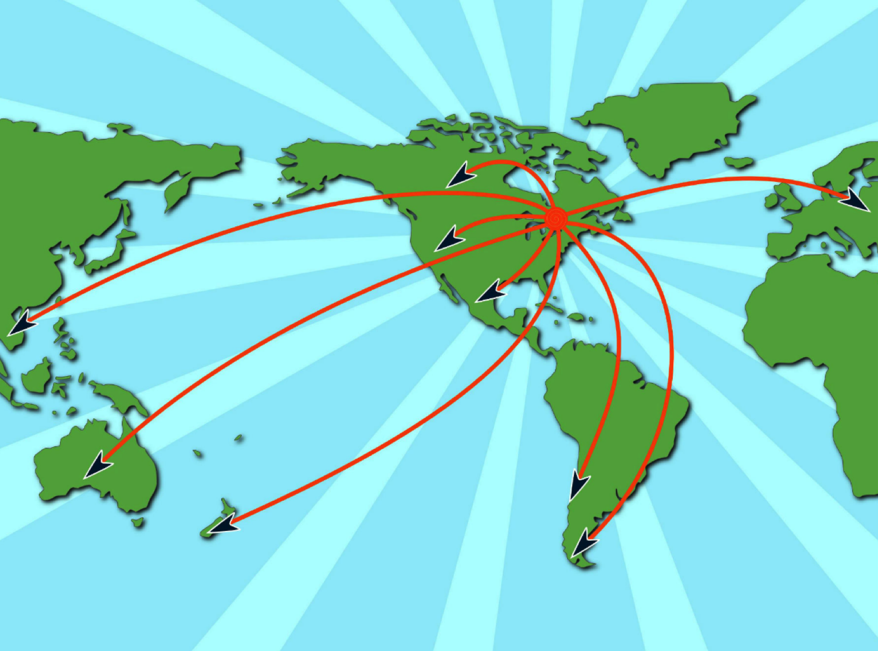

Slide 54
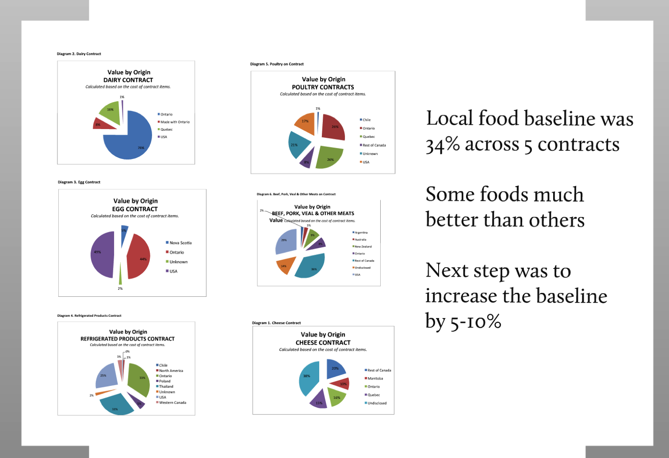

Slide 55
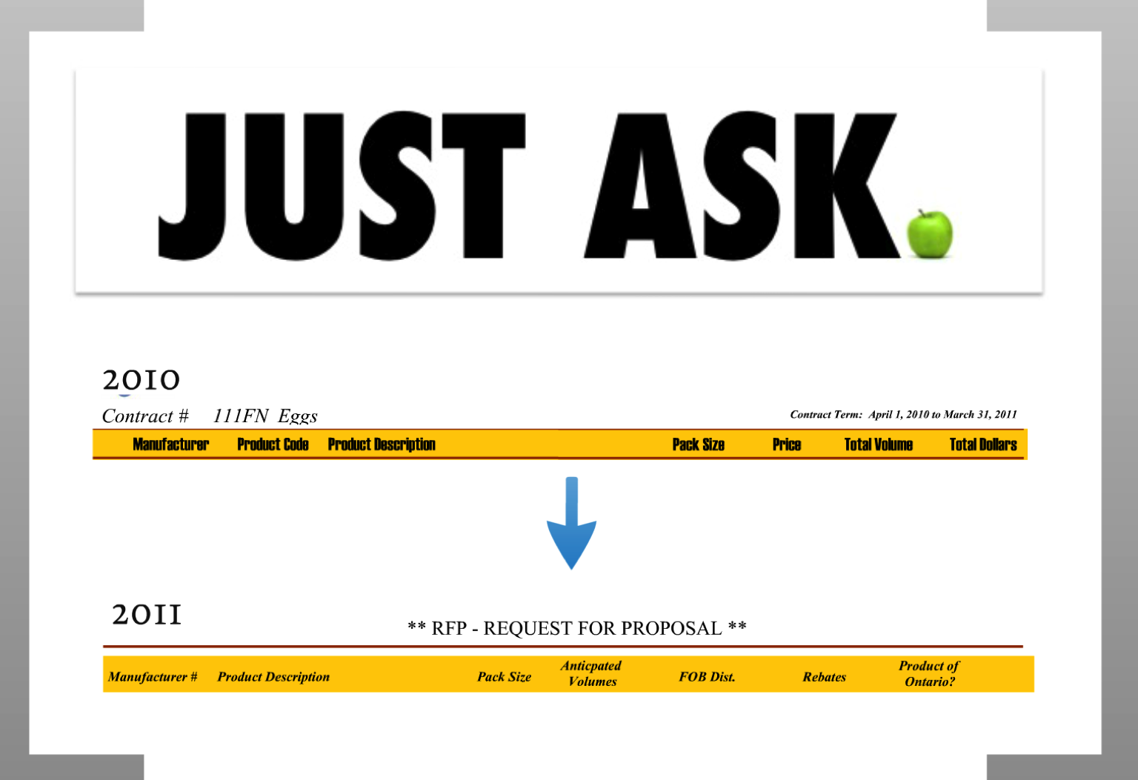

Slide 56
15%

Slide 57
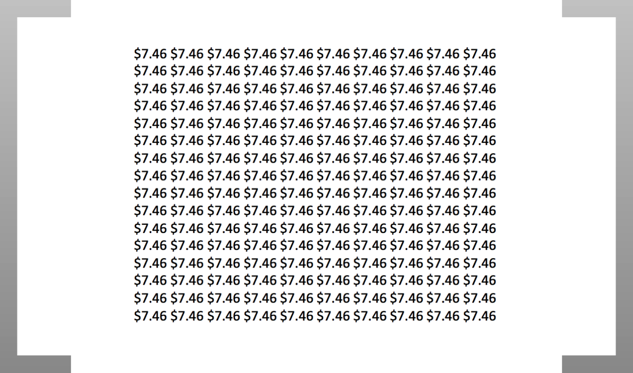

Slide 58
$670,000/yr

Slide 59
$1,300,000/2yrs

Slide 60
Q&A
Any questions?

Slide 61
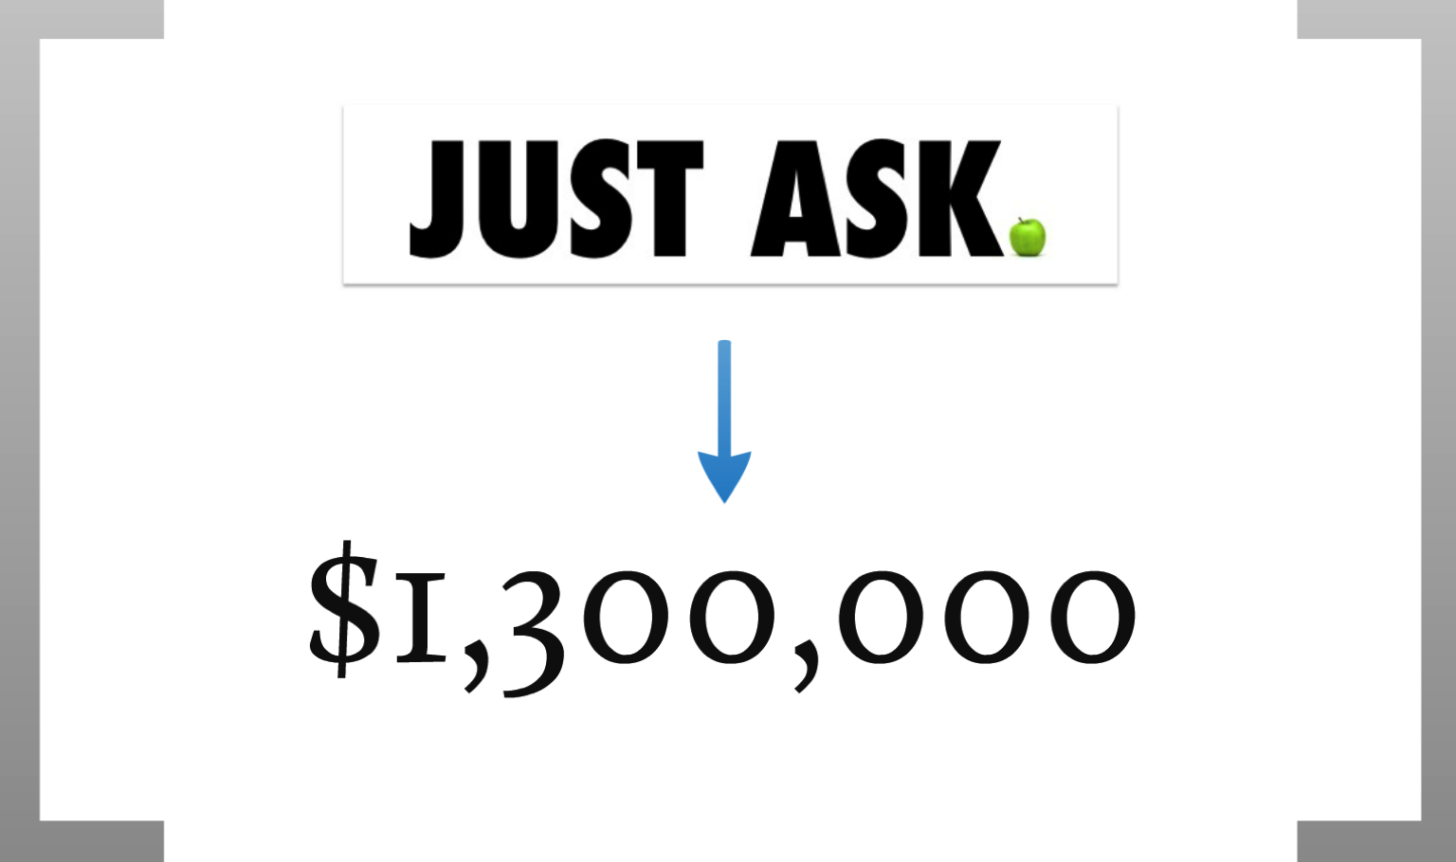

Slide 62
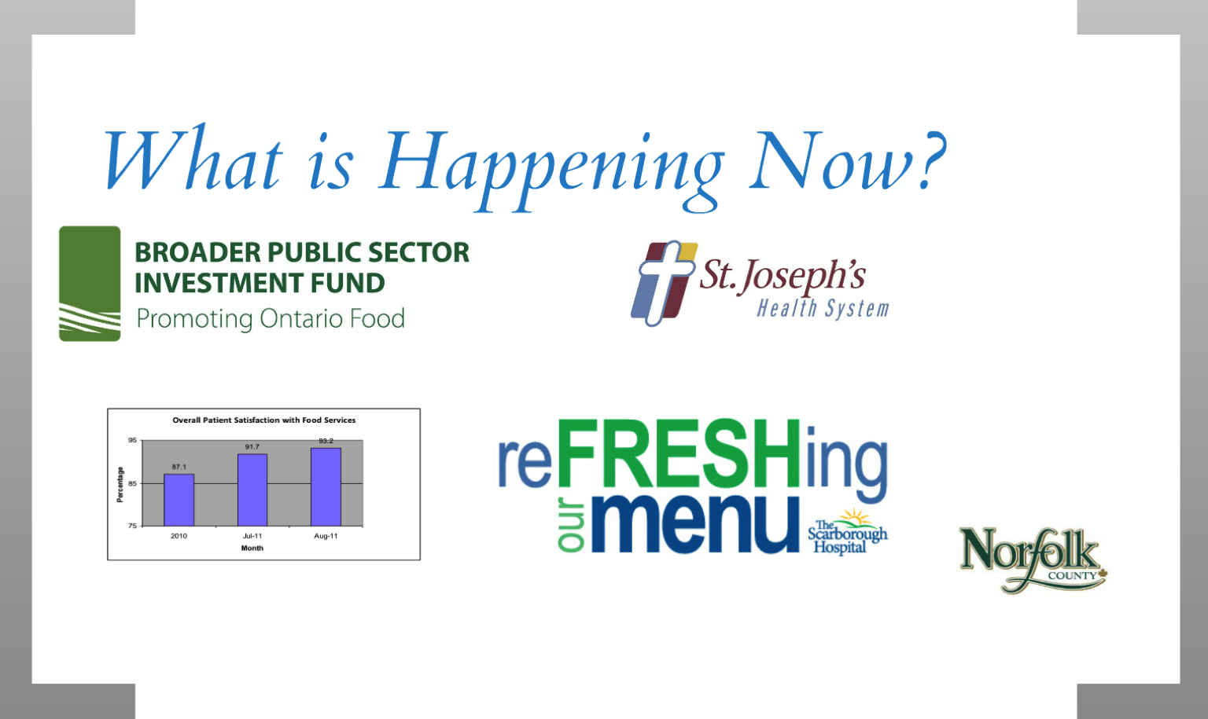

Slide 63


Slide 64
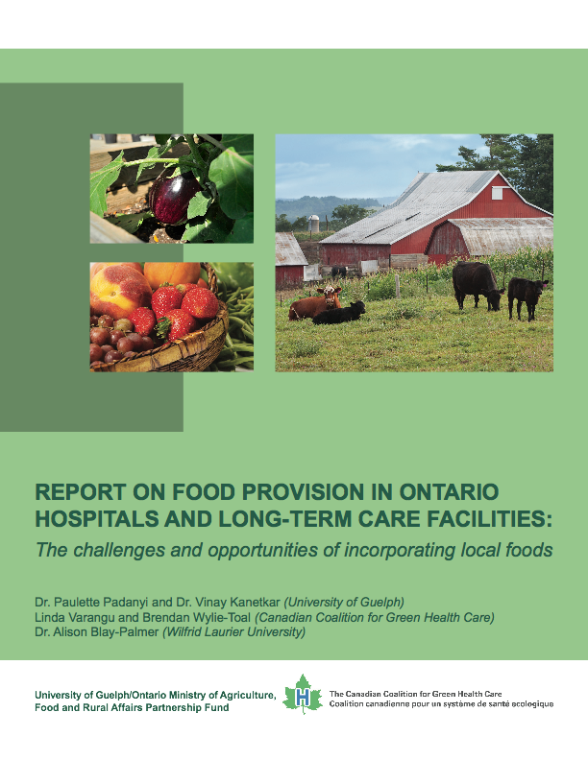
Help
www.greenhealthcare.ca

